Slide 1
MVC & Laravel
intro
PHP WebDevelopment 2019
Милена Томова
Vratsa Software
https://vratsasoftware.com/

Slide 2
Table of Contents
MVC
Framework
Composer
Laravel intro
Installing laravel
Resources
Folder structure
Project assignments

Slide 3
MVC

Slide 4
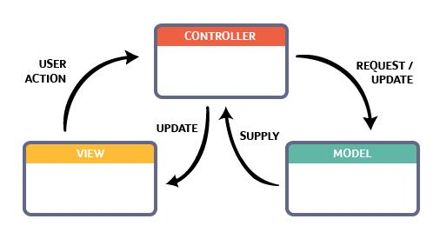
Model View Controller /MVC/
A software design pattern used for developing user interfaces.
MVC divides the related program logic into three interconnected elements -
Model
View
Controller
This is done to separate internal
representations of information
from the ways information is presented
to and accepted from the user.

Slide 5
MVC
Model
The central component of the pattern. It is the application's dynamic data structure, independent of the user interface. It directly manages the data, logic and rules of the application.
View
Any representation of information such as a chart, diagram or table. It is what the user sees on the screen.
Controller
Accepts input and converts it to commands for the model or view.

Slide 6
MVC
In addition to dividing the application into these components, the model–view–controller design defines the interactions between them.
The model is responsible for managing the data of the application. It receives user input from the controller.
The view means presentation of the application`s data in a particular format.
The controller responds to the user input and performs interactions on the data model objects. The controller receives the input, optionally validates it and then passes the input to the model.

Slide 7
Composer

Slide 8
Framework
Software - pre-built and pre-tested code segments and functionalities -
that is developed and used by developers to build applications.
As a programmer, you don’t need to start from scratch your projects.
Using a software framework to develop applications lets you
focus on the high-level functionality of the application.
This is because any low-level functionality is taken care of by the framework itself.

Slide 9
Framework
Advantages of using a software framework:
Assists in establishing better programming practices and fitting use of design patterns
Code is more secure
Duplicate and redundant code can be avoided
Helps consistent developing code with fewer bugs
Makes it easier to work on sophisticated technologies
One could create their software framework or contribute to open-source frameworks. Hence, there is a continuous improvement in the functionality
Several code segments and functionalities are pre-built and pre-tested. This makes applications more reliable
Testing and debugging the code is a lot easier and can be done even by developers who do not own the code
The time required to develop an application is reduced significantly

Slide 10
Framework

Slide 11
Composer
Installation
Composer is a tool for dependency management in PHP.
It allows you to declare the libraries
your project depends on and it will manage (install/update) them for you.
composer.json is where all of the project libraries are listed.

Slide 12
Laravel

Slide 13
Convention over configuration
Laravel
Laravel focuses on convention instead of the configuration
You`ll spent less time for initial project setup compared to other frameworks, when using Laravel default configuration. Even if you have to customize default settings, it is no problem at all.
Compared to other PHP frameworks, Laravel requires less time for developing a project.

Slide 14
Simplicity
Laravel
Laravel focuses on simplicity
The documentation and Laravel community will always recommend to resolve any problem or task with the simplest implementation possible.

Slide 15
Expressive, Dynamic, Simplified
Laravel
Laravel focuses on simplicity
Taylor Otwell /the creator/ of Laravel and his followers are connected and inspired by Ruby on Rails and programming languages that use functional programming.
There is a strong current in the modern PHP that supports and tends to complicate and aggravate the development, supporting the JAVA like features of PHP.
Laravel tends to be on the other side - it supports the expressive, dynamic and simplified practices and features of the programming language.

Slide 16
The Community
Laravel
Laravel community
A distinctive component of Laravel, contributing to his growth and success, is its constantly growing community.
Laravel has a diverse and vibrant community of people who have supported him since day one.

Slide 17
The Community
Laravel
Laravel community
A distinctive component of Laravel, contributing to his growth and success, is its constantly growing community.
Laravel has a diverse and vibrant community of people who have supported it since the day one.
… From the very beginning of Laravel, I’ve had this idea that all people want to feel like they are part of something. It’s a natural human instinct to want to belong and be accepted into a group of other like-minded people.
So, by injecting personality into a web framework and being really active with the community, that type of feeling can grow in the community.
—Taylor Otwell,Product and Support interview

Slide 18
The Documentation

Slide 19
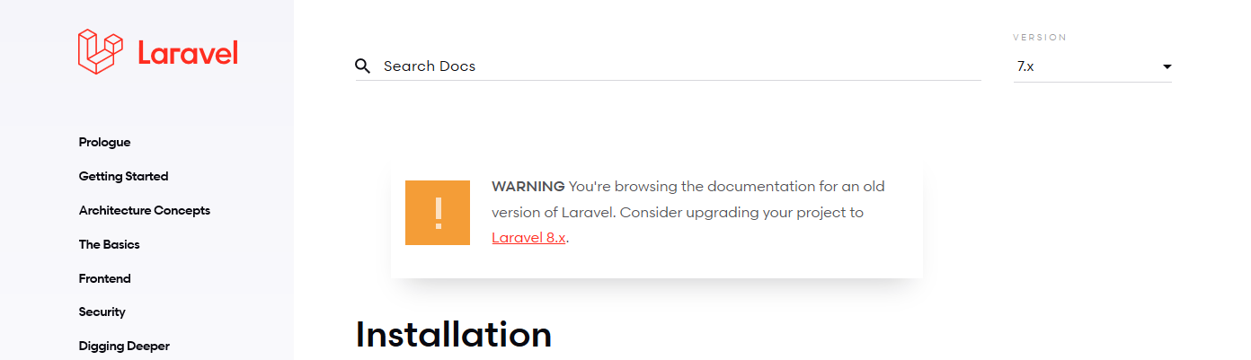
The Documentation
Always select the Laravel version before reading the documentation!

Slide 20
Installing Laravel

Slide 21
Installing Laravel
Check server requirements
Installing Laravel
Via Laravel Installer
composer global require laravel/installer
laravel new blog
Via Composer Create-Project
composer create-project --prefer-dist laravel/laravel:^7.0 blog

Slide 22
Installing Laravel
Open Git Bash in the folder where the project will reside!
Via Laravel Installer
composer global require laravel/installer
laravel new blog
Via Composer Create-Project
composer create-project --prefer-dist laravel/laravel:^7.0 blog

Slide 23
Installing Laravel
Access the project folder in the browser with
localhost/path-to-project-folder/public

Slide 24
Resources

Slide 25
Resources
https://laracasts.com/
Edwin Diaz - PHP with Laravel, Become a master in Laravel /for Laravel 5.x/

Slide 26
Folder Structure

Slide 29



Trainings @ Vratsa Software
Vratsa Software – High-Quality Education, Profession and Jobs
www.vratsasoftware.com
The Nest Coworking
www.nest.bg
Vratsa Software @ Facebook
www.fb.com/VratsaSoftware
Slack Channel
www.vso.slack.com

